Slide 1
T-Design

Slide 2
Description
T-Design is a site which user can create patterns for T-shirt
Also has many t-shirt you may purchase .
The company will also purchase any Design that users have created
The target audience is ages from 18-30+
This is the target audience because the company only has a site no stores.
Also to bring artist in together to create unique types of styles

Slide 3
Color Scheme
1) Navy Blue
2)Light Green
3)Light Purple
4)Dark Blue

Slide 4
Fonts
1)Pacifico
2)Handlee
3)Yellowtail
4)Norican

Slide 5
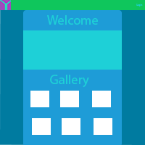
Cover Page

Slide 6

Logo

